Slide 1
IMPACT MEASUREMENT
IMPACT MANAGEMENT

Slide 2

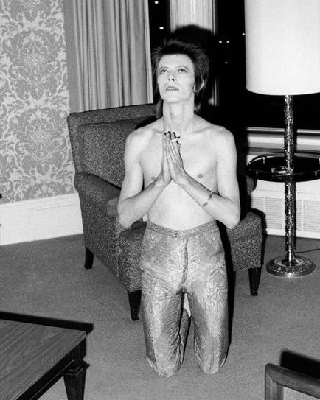
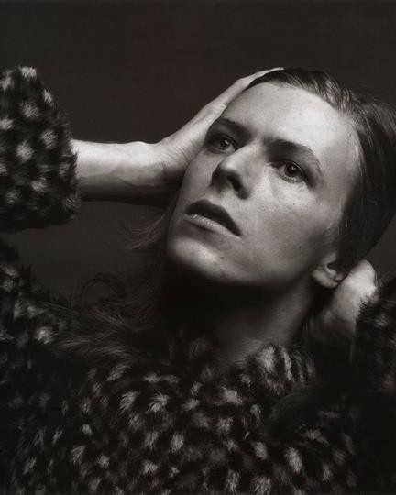
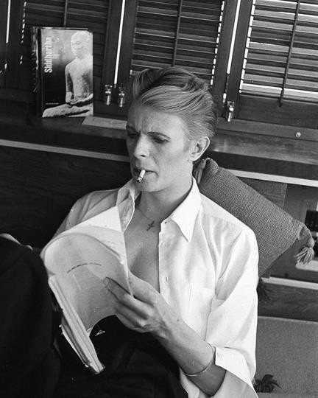
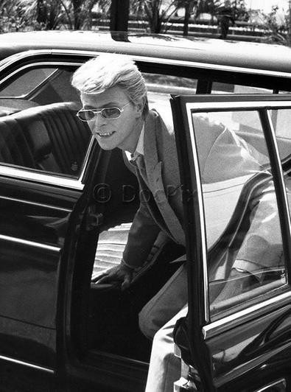
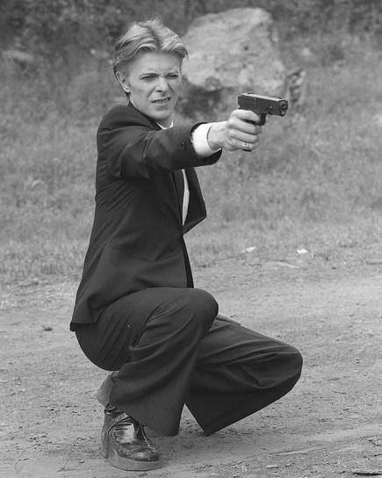
Impact Measurement
God
help me
I'm gonna crack it
Confused
Getting there
Killin it
I have no idea what is my social mission
I know what is my social mission but I don't understand how to measure it nor why to measure it anyway.
I know what is my social mission and I understand the importance of communicating it, but I'm lacking the knowledge and tools for measurement.
I understand what is my social mission and how to measure it but I need additional support and guidance.
I have a clear idea how to measure my social mission and why is that important.
Notes:
Choose your DB – act as a statue that depicts the best how are you feeling about imact management and measurement

Slide 3








Who will benefit from your work? Who is your main target group?
Young people from vulnerable groups
People in my
community
People from
rural areas
People living in
poverty
Persons
with disabilities
Woman from
vulnerable groups
Young
people
People in all WB6
region
Notes:
Take a flipchart in front of you and wtite down who are your beneficiaries – who will be affected in a positive way by the activities of your SE
Always have in mind who are your beneficiaries because they are your main source of information, they are the ones who will tell you how meaningful your imapact in for them

Slide 4
IMPACT MEASUREMENT
Who else is affected by your activities or have an effect on your activities? Who are your key stakeholders?
YOUNG PEOPLE
OTHER ORGANISATIONS
PUBLIC INSTITUTIONS
PARENTS FAMILIES
OTHER BUSINESSES
INTERNATIONAL AID AND DONORS
OTHER GROUPS OF PEOPLE
PEOPLE IN MY COMMUNITY
OTHER
Notes:
Other organizatuons – other CSO working around the same or complimentary topic, around the same target group
Other business – other business with same or similar social mission, business that can be your suppliers or you can offer them your services
Public institution – local self governance, anyone from the public sector that is providing health, educational or social service, policy making and laws

Slide 5
IMPACT MEASUREMENT AGENDA TODAY
10.00– 10.40 Upoznavanje; Zajedno o socijalnom preduzetništvu
10.40 – 12.10 Društveni uticaj: Osnove, metodologija i primer Dobre Torbe
12.10 – 12.30 Pauza za kafu
12.30 – 13.15 Merenje društvenog uticaja u praksi - Individualni rad na TOC-u
13.15 – 14.15 Predstavljanje individualnih TOC -ova i zajednička diskusija
14.15 – 14.45 Zatvaranje dana i sumiranje utisaka

Slide 6
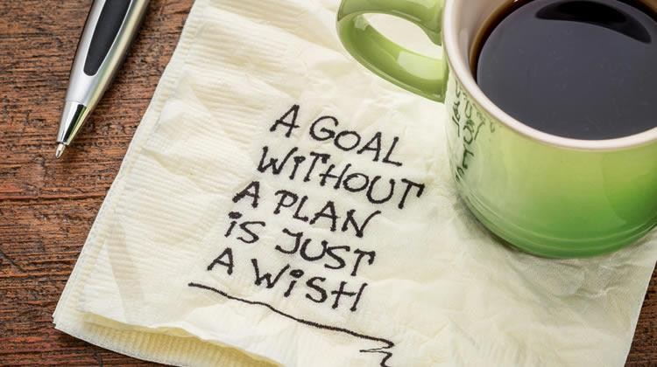
EXPECTATIONS AND GOALS FOR TODAY
How to measure social impact
How to define indicators
How to understand what is important and start simple
How to measure something which is not quantifiable?
How to use it to maximize impact you create

Slide 7

BASICS: SOCIAL IMPACT
SOCIAL IMPACT
Changes in people lives.
Long-term changes we create in people lives.
SOCIAL VALUE
Way of quantifying the relative importance of impacts that are not captured in financial or market transactions. The value our impact has in the community.
MEASURING IMPACT
Collecting quantitative and qualitative data on our impact
over time.
MANAGING IMPACT
Analyzing data, assessing if our strategy is working;
change, improve, stop or scale what we do

Slide 8
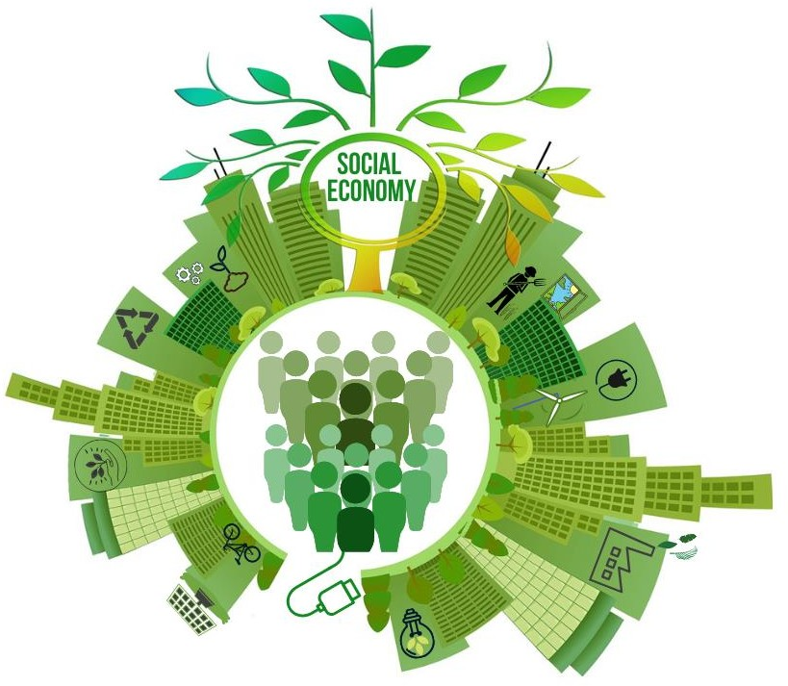
BASICS: WHY MEASURING SOCIAL IMPACT
SOCIAL ENTERPRISE
ECOSYSTEM
Confirmation of your social
mission
Better management and decisions
Satisfied stakeholders: beneficiaries, customers, community
Access to support and finance
Inspire other social actors and entrepreneurs
Showcase the impact of
social enterprises
Improved access to finance and more investors
Advocacy
Notes:
Use the data to design or redisgn your activities/product/services to maximize your impact and to make sure that your impact is meaningful for your beneficiaries
2. Postion your self as responsinble and trustworthy business – in the same way you are producing your financial report you shold crate your impact report
3. More investors are looking for measurable impact prior to making a decision whether to invest in some business or not
4. Showcase to the state and the goverment the importance of SE to national economy – in this way it is much easier to persuade them into caming up with financial intruments that are tailor made to the needs if SE or come up with a modern and favorable law for SE

Slide 9


BASICS: SOCIAL IMPACT
HOW TO START?
Understand the social issue you want to change – Social persona, Stakeholders
Develop your strategy and goals for impact to address the social issue – Theory of change
Design your activities to have maximum social impact (product, services etc.)
Develop plan for collecting data
Analyze your data and use them to improve your strategy and activities
Notes:
If I had an hour to solve a problem I’d spend 55 minutes thinking about the problem and 5 minutes thinking about solution. Albert Ainstain – what are the causes of the poblme, how big is the problem, who are people who are affected by the proble, is there any other solution what is tackling that isuess and so on- Ideation phase
2. Theory of change – we will work on this one today
3 Then based on the goals you set in your TOC you design the activities of your SE in order to achieve those goals
4. Develop plan for collecting data – qualitative and quantitaive
5. Analyze your data and use them to improve your strategy and activities – nothing is set in stone meaning data is there to help you to improve your strategy and activities based on the feedback you received. Use the feedback and info to really tailor your activiities in order to produce the meaningul impact for your beneficiaries.

Slide 10

BASICS: SOCIAL IMPACT
10 KEY QUESTIONS
What problem are we trying to solve?
What is proposed solution to the problem?
Who is experiencing changes in lives as a result of what we do?
What changes?
How we can measure these changes?
How much of each change is likely to happen?
How much of each change is caused by our activities?
How long do we need to measure changes for?
What is relative important of different changes?
Which changes matter and are important for us ?
Notes:
7. We have to be sincere here – not everything that changes will be thanks to our effort and our SE activities, for example lets take Prezla as and example – right now in Monetengro big supermarket chains have to pay taxes if they want to donate foodleftovers, But if goverment decides to cut and cancle those taxes, probably the donation rate will increase but that will be thank to all these stake holders, not only your SE
8.Some results of the activities can bee seen right away – for example 30 RISErs partcipated in Bootcamp and improved their knowledge on certain topics. But for some other results in take a much longer period of time – for example SE that are working with kids like Kamp and Earth soldiars will have to track those kids and their parents for much longer period of time in order to see did they grow up in eco cinscious youn people – 10 years period
10 Once again – talking with your beneficiaries and being emphatetic towards them, trying to uderstand them and their point of view will help them to understnd what is really importnat to them – then you will measure

Slide 11



BASICS: METHODOLOGIES
METHODOLOGY: IMPACT MANAGEMENT PROJECT
https://impactmanagementproject.com/ - Thousands of practitioners have come together to agree on a shared understanding of impact.
Want more reading? Check: Maximise Your Impact Guide
Notes:
IMP – framework for impact measurement that is accepted by most influetional europe organisations that are in tge field of social economy and impact. Using this internationally recognized framework will help you to communicate and promote your impact on the interntional level and potential international donors.

Slide 12
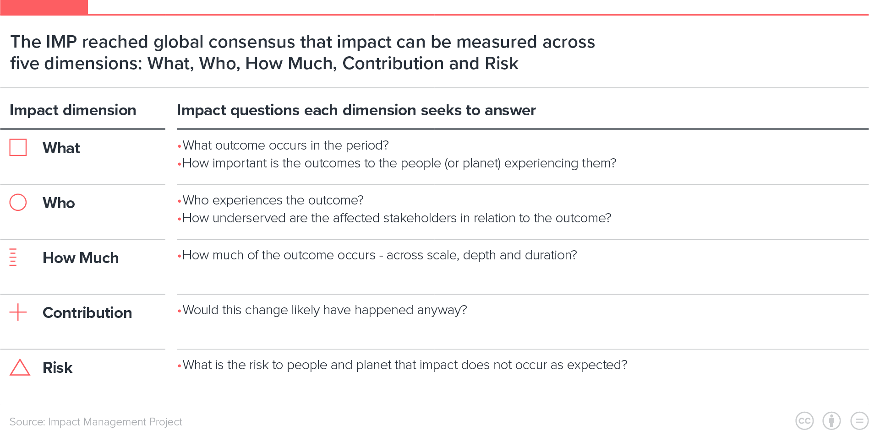

IMPACT MANAGEMENT PROJECT

Slide 13
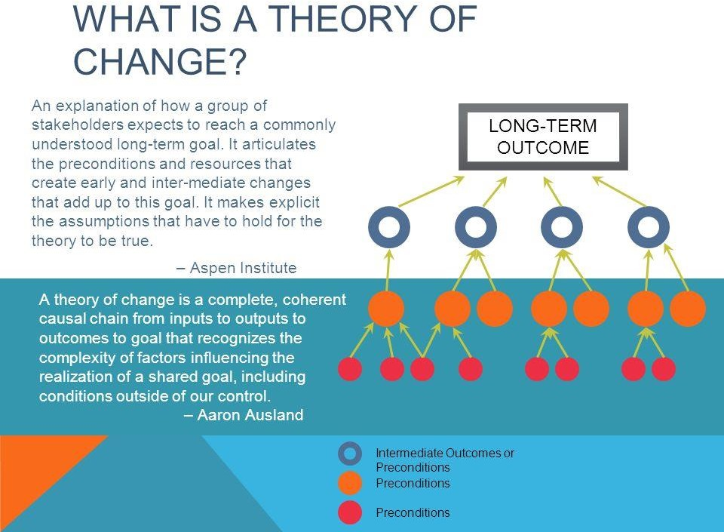
BASICS: THEORY OF CHANGE
THEORY OF CHANGE
IMPACT – long term goal
Outcomes - Changes
Outputs – Expected rersults
Activities
Resources

Slide 14

BASICS: SOCIAL IMPACT
RESULTS or OUTPUTS
Direct results of the activities.
ACTIVITIES
All the things social enterprise do: deliver products and services; offer programs and carry out advocacy.
OUTCOMES
Change that happen as a result of the activities of SE.
SOCIAL IMPACT
Changes in people lives.
Long-term changes we create in people lives.
Notes:
Always go backwards, from social impact which is like long term goal 3 – 5 years, otcomes – changes in peoples bahaviour that are happening in the period from 1 to 3 years and then activities – activities are something that you produce in the short period of time – for example production, sales, trainings for future employes, cooperation with other stakeholders etc

Slide 15
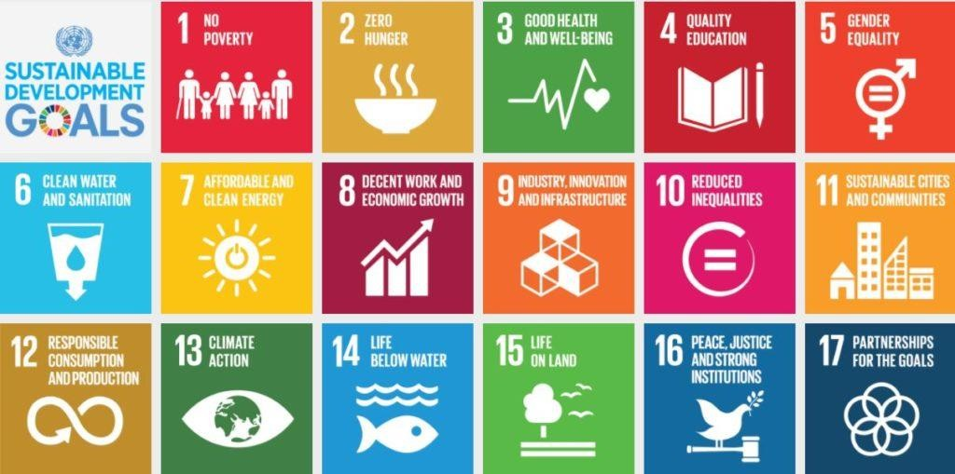
BASICS: WHAT AND HOW TO MEASURE> INDICATORS
More info on indicators: https://ec.europa.eu/eurostat/web/sdi/indicators
Notes:
Global consesus of what are the key goals for the whole mankind – the easistes way to showcase your imoact and to get the undersanding and recognition of iinternational stakeholders is to say we are contrubuting to for exmple SDG no 10 – again like theory of change , those frameworks and methodologies are good becaaue they set a standard that anyone from the impact field can understand

Slide 16
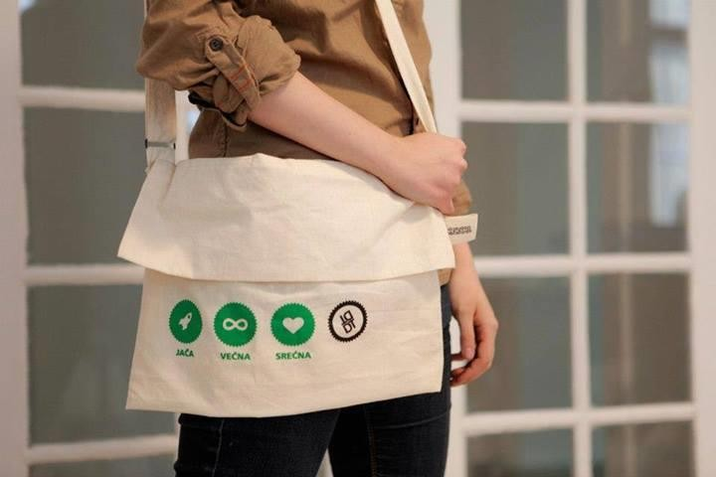
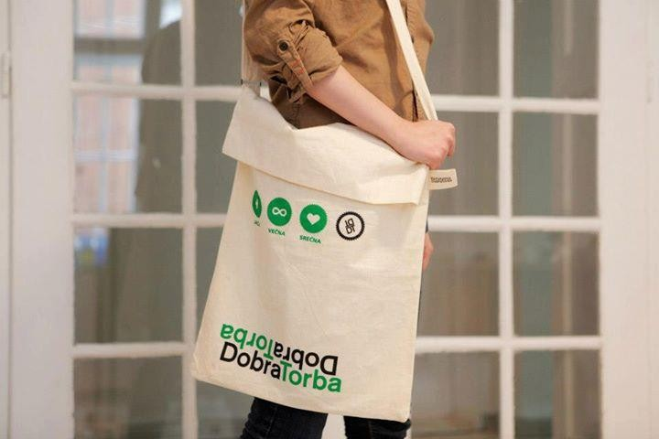

CASE STUDY: DOBRA TORBA // THE GOOD BAG
The Good Bag is better...
...because it's one of a kind – both as a bag and as an example of social
entrepreneurship in Serbia.
It's made by unemployed women gathered around several associations from all over the country, and the entire income made from the sale is going straight into their hands
Original domestic design, hand–made production and universal values – that is what you support by buying the Good Bag.
Plus, you are getting a bag that is unique, beautiful, long–lasting and suitable for every occasion.
These branded promotional bags are ideal for an efficient and innovative business promotional gift.
MORE ABOUT GOOD BAG
https://www.dobratorba.rs/en/ https://www.youtube.com/watch?v=v6lJKrzp_Bc https://www.youtube.com/watch?v=DgPiBqBO5x0

Slide 17
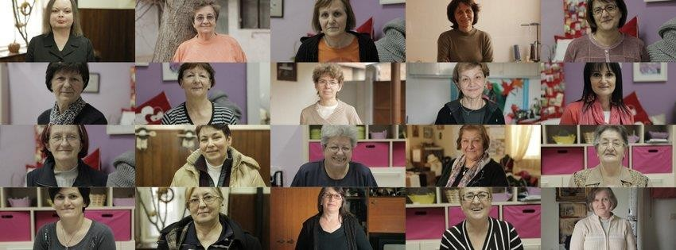
CASE STUDY: DOBRA TORBA // THE GOOD BAG
The Good Bag is better because she's pretty, practical and strong like the women who make her.
MORE ABOUT GOOD BAG
https://www.dobratorba.rs/en/ https://www.youtube.com/watch?v=v6lJKrzp_Bc https://www.youtube.com/watch?v=DgPiBqBO5x0

Slide 18
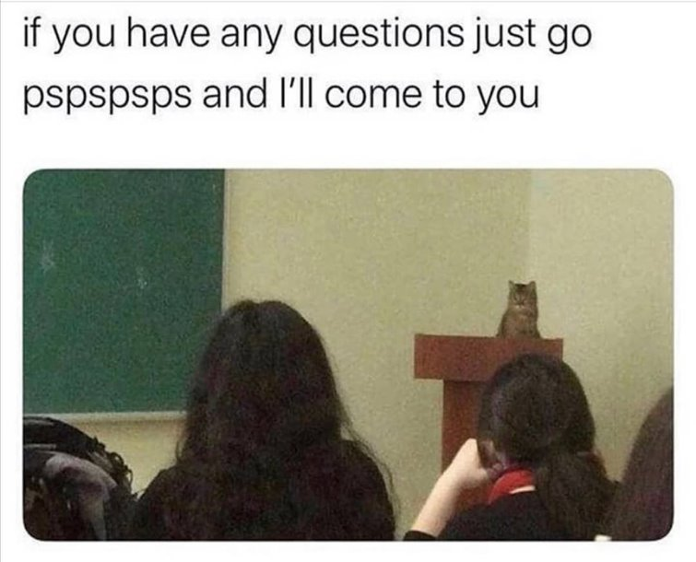

Slide 19
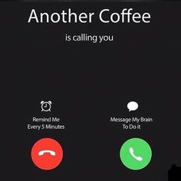

Slide 20

Exercise: TOC your idea
Duration: 45 minutes
Feel fee to ask and bother your group members for feedback ☺

Slide 21
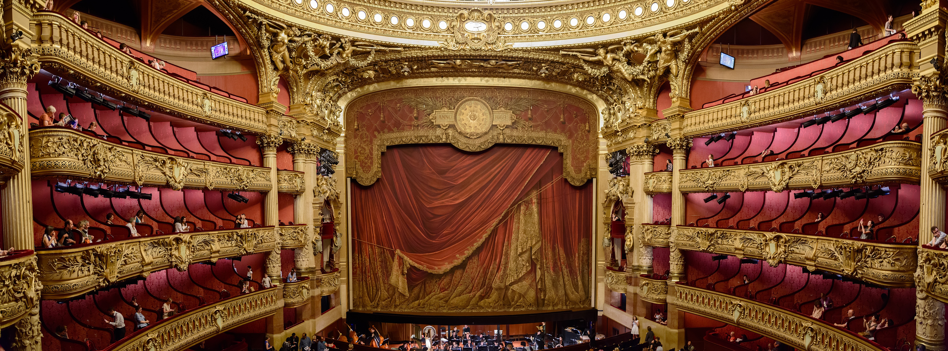
SHOWTIME

Slide 22

Notes:
Ivana

Slide 23


Contact us, we smart ->
SK FB
SK IG
jelena@smartkolektiv.org
00 381 63 599945
SK WEB

